Slide 1
Unit - 2
Managing Your Source Code with Git

Slide 2
1: Install and configure Git
Step 1: Install and configure Git
https://git-scm.com/install/windows
Step 2: Verify installation. git –version
Step 3: Configure student details
git config --global user.name "Student Name"
git config --global user.email student@gmail.com
Verify: git config --list

Slide 3
2: Create a local Git repository
create a folder named DevOpsLab.
mkdir DevOpsLab
cd DevOpsLab
Check JDK installation
java –version
javac --version
Create a Java file named Hello.java in notepad
javac Hello.java

Slide 4
Step 1: Initialize Git repository
  git init
Step 2: Check repository status
  git status
Step 3: Add the file to the staging area
  git add Hello.java
Step 4: Commit the file
  git commit -m "First commit“
Step 5: View commit history
  git log

Slide 5
3: Modify files and track versions
Modify the Java program by adding
  System.out.println("Learning Distributed Version Control System");
  git status
  git add Hello.java
  git commit -m “Updated Hello Java program”
  git log - - oneline //shows all the commits have been created

Slide 6
4: Create a GitHub remote repository
Create a GitHub account.
Log in to GitHub.
Click New Repository.
Enter repository name as DevOpsLab.
Select Public.
Do not select Add a README file (since you already have a local project).
Click Create repository.
After clicking Create repository, GitHub displays a page containing commands for connecting an existing repository.
Under Quick setup, select HTTPS. https://github.com/shwethamkmanju/DevOpsLab.git

Slide 7
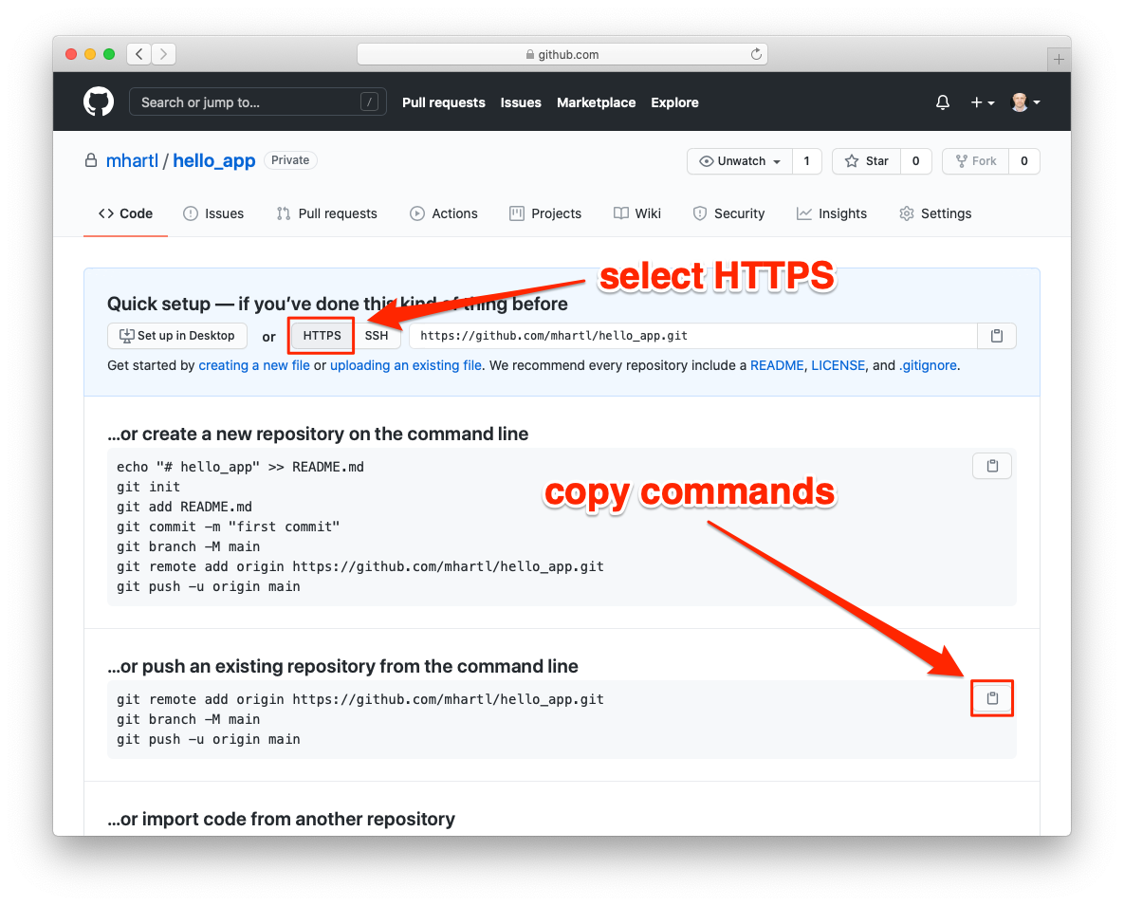

Slide 8
Connect local repository to GitHub.
git remote add origin https://github.com/username/DevOpsLab.git
origin is the conventional name given to the remote repository.
Push local code to GitHub
git branch -M main
git push -u origin main
Ask for authentication (github login mail id and pwd)

Slide 9
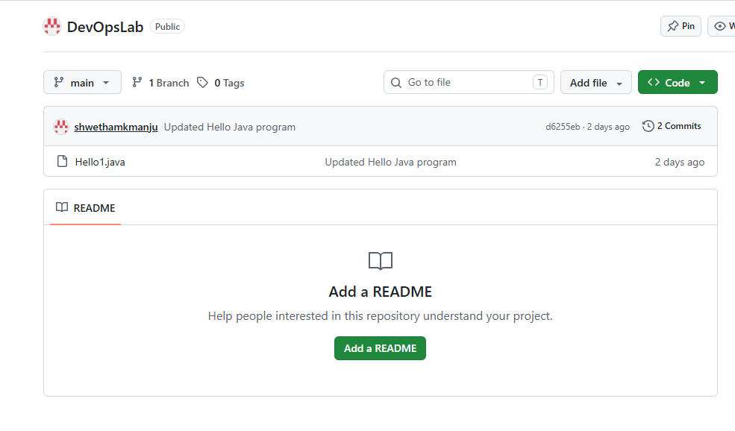
Refresh the GitHub repository and observe the uploaded Java file.

Slide 10
5: Understand pull and clone
Click on Hello.java in github
Click on pencil icon (Edit).
Add the following statement to Hello.java
System.out.println("Edited from github account");
Click on commit changes
In extended description type commit-3 from github
Click on commit changes

Slide 11
clone and pull command
In local system, create a directory devclone in DevOpsLab directory.
clone is used to obtain a complete copy of a remote repository.
git clone https://github.com/shwethamkmanju/DevOpsLab.git
Complete project and its Git history are downloaded to the directory devclone.
In the directory DevOpsLab project/code is not yet updated, so use pull command to obtains remote changes and integrates them into the current local branch.
git pull origin main
git log //shows all the commits have been created

Slide 12
6: Branching and merging
Developers use branches to work on new features without disturbing the main project.
Step 1: Create a new branch
git branch feature1
git branch // list the branches
Step 2: Switch to the new branch
git checkout feature1
Step 3: Modify the Java program Hello.java
System.out.println("New feature1 added");

Slide 13
Step 4: Commit the changes
git add Hello.java
git commit -m "Added new feature1“
git log
Step 5: Switch back to main branch
git checkout main
observe that the new feature is not present in the main branch yet. (check hello.java)
Step 6: Merge the feature branch
git merge feature1
new feature becomes part of the main branch.
git remote –v //Display remote URLs

Slide 14
Fetch command - Downloading updates from the remote repository without merging
Step 1: Check the remote repository
git remote –v
Step 2: Make a change directly in GitHub
Open your DevOpsLab repository on GitHub. Add another print statement to Hello.java :
System.out.println("Learning Git Fetch Command");
Click on commit changes
In extended description type commit-5 for fetch
Click on commit changes
Step 3: Execute Git Fetch
git fetch origin
The commit has been downloaded, but your local main branch has not been updated.
Step 4: Check the difference
git log //only shows previous commits
git status

Slide 15
Step 5: Merge the fetched changes
git merge origin/main
find conflict markers similar to these
<<<<<<< HEAD
System.out.println("Welcome to DevOps");
=======
System.out.println("Learning Git Fetch Command");
>>>>>>> origin/main
Edit the file and retain both statements and Remove all conflict markers (<<<<<<<, =======, >>>>>>>).
Mark the conflict as resolved
git add Hello.java
git commit -m "Resolved merge conflict“
Step 6: Verify the result
git status

Slide 16
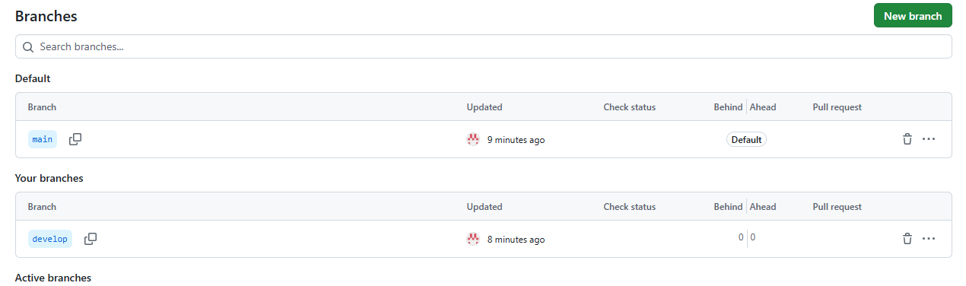
Step 1: Create develop branch
git checkout main
git checkout develop
Push it to GitHub: git push -u origin develop

Slide 18
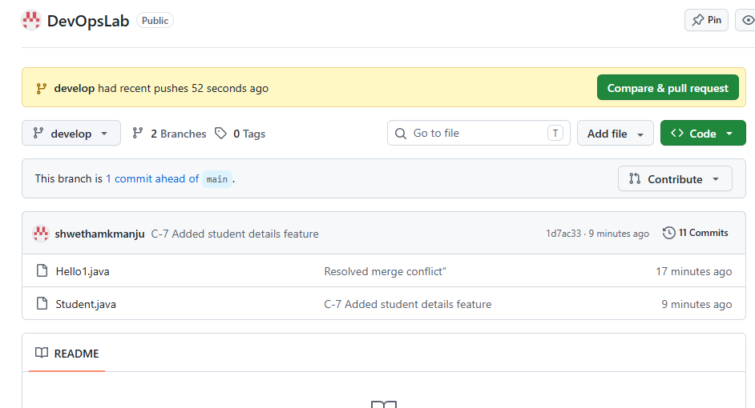
Step 3: Merge feature into develop
git checkout develop
git merge feature/student-details
git push origin develop
Click on develop branch in github : Student.java is added

Slide 19
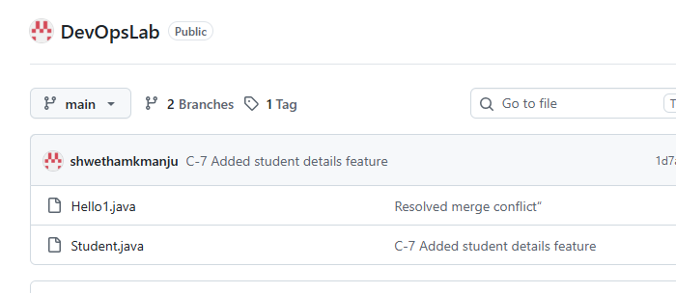
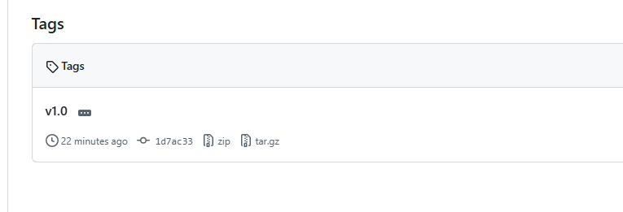
Step 4: Create a release branch
git status // in the branch develop
git checkout –b release/v1.0 // -b Create and switch branch
This branch is used for final testing and release preparation. After testing: switch back to main branch
git checkout main
git merge release/v1.0
Tag the release:
git tag v1.0
git push origin main –tags
Click on Tag

Slide 20
Step 5: Create a hotfix branch
git status
git checkout main
git checkout -b hotfix/fix-student-error
git merge hotfix/fix-student-error
git checkout develop
git merge hotfix/fix-student-error

